Slide 1

Kona Billfish Nursery Project
Phase 1 & 2 Updates
13 April 2023

Slide 2
Project Goals & Structure
Phase 1
Examine literature and historical data in a meta-analysis to determine larval istiophorid abundance patterns and habitat in the Pacific Ocean. Nominate putative spawning areas and develop age & growth models. Spatial data analysis to test for Complete Spatial Randomness and analysis of temperature and salinity data.
Phase 2
Data from Phase 1 will be used to inform oceanographic circulation models to estimate patterns in larval diversity and connectivity by conducting simulations.
Using age and growth and circulation models, determine possible spawning sites and larval habitat over temporal-spatial scales.

Slide 3
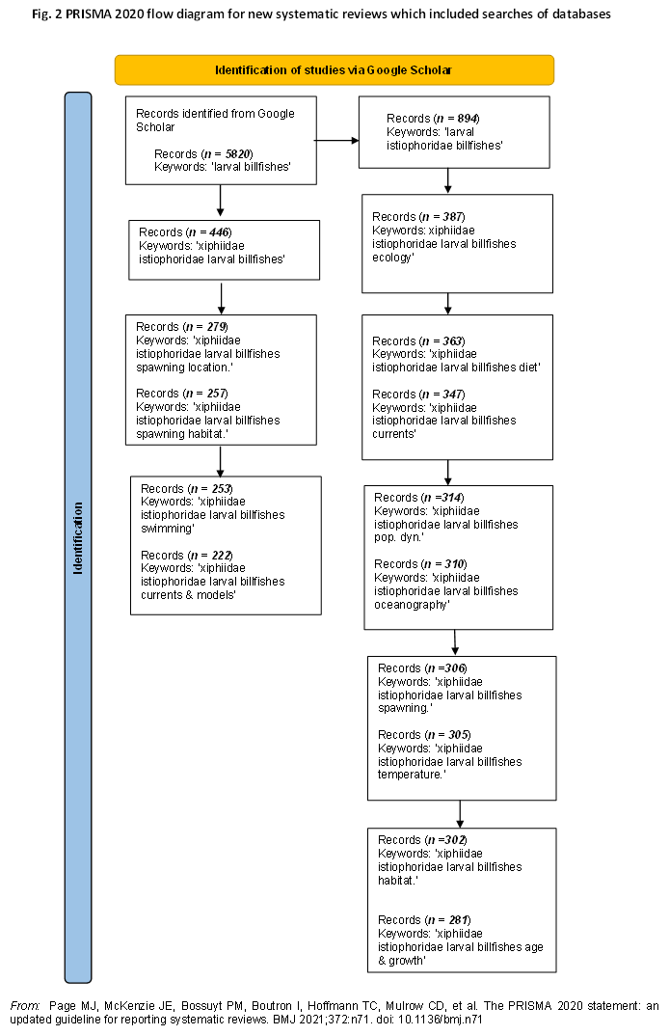
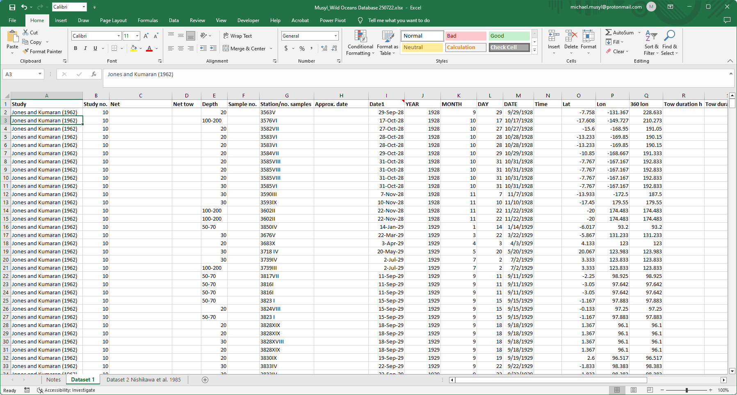
Phase 1
Search literature Data extraction Create database
~80% of available data

Slide 4
Records of larval samples in Dataset 1
Samples from 1928-2019 (various sources)
Species | Count Species | Count Latitude | Count Longitude | Count Salinity | Count Temp | Count size (mm)
Black marlin | 92 | 92 | 92 |  | 1 | 92
Blue marlin | 282 | 282 | 282 | 32 | 177 | 282
Istiophorid | 146 | 79 | 79 | 5 | 21 | 122
Sailfish | 86 | 86 | 86 |  | 22 | 79
Shortbill spearfish | 93 | 81 | 81 | 52 | 73 | 93
Striped marlin | 94 | 94 | 94 | 7 | 10 | 94
Swordfish | 95 | 59 | 59 | 26 | 48 | 88
Grand Total | 888 | 773 | 773 | 122 | 352 | 850
Note: It is highly probable that larval istiophorids have been misidentified to species level using morphometric characters. What the rate of misidentification is unknown but blue and striped marlin are mixed-up and occasionally black marlin.
Records of larval samples in Dataset 2
Species | Count Species
Sailfish | 292
Swordfish | 591
Black marlin | 5
Blue marlin | 2466
Shortbill spearfish | 739
Striped marlin | 442
Grand Total | 4535
Note: Data spatially aggregated ~1.5°. Sample sizes of larval billfish 1956-1981 (source: Nishikawa et al. 1985)

Slide 5
Sample Sizes for Species with known collection coordinates (FAO Codes)
YEAR | BLM | BUM | IST | MLS | SPA | SSP | SWO | Total | Cum. %
1928 | 1 | 11 | 0 | 0 | 1 | 0 | 1 | 14 | 0.02
1929 | 9 | 25 | 0 | 16 | 46 | 0 | 8 | 104 | 0.15
1930 | 0 | 0 | 0 | 3 | 8 | 0 | 0 | 11 | 0.17
1937 | 0 | 0 | 0 | 0 | 0 | 0 | 1 | 1 | 0.17
1950 | 0 | 36 | 7 | 0 | 0 | 5 | 8 | 56 | 0.24
1952 | 0 | 0 | 0 | 0 | 0 | 1 | 0 | 1 | 0.24
1953 | 0 | 1 | 0 | 0 | 0 | 0 | 0 | 1 | 0.24
1956 | 0 | 1 | 1 | 0 | 0 | 18 | 3 | 23 | 0.27
1957 | 0 | 2 | 0 | 0 | 0 | 7 | 18 | 27 | 0.31
1958 | 0 | 5 | 1 | 0 | 0 | 1 | 2 | 9 | 0.32
1959 | 0 | 4 | 3 | 0 | 0 | 7 | 3 | 17 | 0.34
1960 | 0 | 9 | 2 | 0 | 0 | 0 | 0 | 11 | 0.36
1961 | 0 | 10 | 4 | 0 | 0 | 7 | 0 | 21 | 0.38
1962 | 0 | 34 | 5 | 0 | 2 | 6 | 0 | 47 | 0.44
1963 | 0 | 36 | 3 | 0 | 10 | 7 | 0 | 56 | 0.52
1964 | 0 | 27 | 2 | 0 | 0 | 7 | 4 | 40 | 0.57
1965 | 0 | 1 | 0 | 0 | 0 | 6 | 0 | 7 | 0.58
1967 | 0 | 10 | 0 | 0 | 0 | 0 | 0 | 10 | 0.59
1969 | 0 | 5 | 0 | 0 | 0 | 8 | 0 | 13 | 0.61
1970 | 0 | 0 | 0 | 0 | 0 | 0 | 4 | 4 | 0.61
1971 | 0 | 30 | 0 | 0 | 0 | 1 | 0 | 31 | 0.65
1983 | 0 | 0 | 0 | 0 | 0 | 0 | 2 | 2 | 0.65
1985 | 82 | 35 | 0 | 0 | 12 | 0 | 0 | 129 | 0.82
1989 | 0 | 0 | 50 | 0 | 0 | 0 | 5 | 55 | 0.89
1990 | 0 | 0 | 1 | 3 | 0 | 0 | 0 | 4 | 0.90
1991 | 0 | 0 | 0 | 13 | 2 | 0 | 0 | 15 | 0.92
1992 | 0 | 0 | 0 | 49 | 5 | 0 | 0 | 54 | 0.99
1993 | 0 | 0 | 0 | 3 | 0 | 0 | 0 | 3 | 0.99
2005 | 0 | 0 | 0 | 7 | 0 | 0 | 0 | 7 | 1.00
Total | 92 | 282 | 79 | 94 | 86 | 81 | 59 | 773
52%
1963
90%
1990

Slide 6
Catch by Month for Species
MONTH |  | BLM |  | BUM |  | IST |  | MLS |  | SPA |  | SSP |  | SWO |  | Total |  | %
1 |  | 82 |  | 44 |  | 2 |  | 3 |  | 17 |  | 5 |  | 3 |  | 156 |  | 0.20
2 |  | 0 |  | 15 |  | 2 |  | 0 |  | 2 |  | 3 |  | 0 |  | 22 |  | 0.03
3 |  | 0 |  | 10 |  | 2 |  | 0 |  | 0 |  | 2 |  | 1 |  | 15 |  | 0.02
4 |  | 0 |  | 4 |  | 1 |  | 0 |  | 4 |  | 7 |  | 5 |  | 21 |  | 0.03
5 |  | 0 |  | 13 |  | 0 |  | 7 |  | 7 |  | 16 |  | 28 |  | 71 |  | 0.09
6 |  | 0 |  | 18 |  | 2 |  | 24 |  | 1 |  | 2 |  | 5 |  | 52 |  | 0.07
7 |  | 0 |  | 32 |  | 7 |  | 0 |  | 1 |  | 7 |  | 2 |  | 49 |  | 0.06
8 |  | 0 |  | 33 |  | 7 |  | 9 |  | 1 |  | 11 |  | 0 |  | 61 |  | 0.08
9 |  | 0 |  | 11 |  | 1 |  | 7 |  | 11 |  | 11 |  | 6 |  | 47 |  | 0.06
10 |  | 9 |  | 61 |  | 55 |  | 8 |  | 24 |  | 17 |  | 8 |  | 182 |  | 0.24
11 |  | 1 |  | 17 |  | 0 |  | 29 |  | 5 |  | 0 |  | 1 |  | 53 |  | 0.07
12 |  | 0 |  | 24 |  | 0 |  | 7 |  | 13 |  | 0 |  | 0 |  | 44 |  | 0.06
Total |  | 92 |  | 282 |  | 79 |  | 94 |  | 86 |  | 81 |  | 59 |  | 773

Slide 7
Salinity and Temperature Conditions at Capture
Salinity at capture (‰)
95% CI 34.7 - 34.9 ‰ (all samples)
Temperature at capture (°C)
95% CI 26.7 – 27.0 °C (all samples)

Slide 8
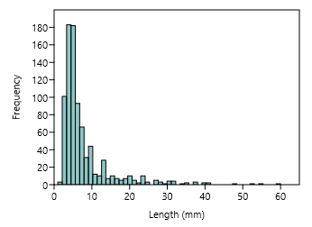
Age & Growth
Exponential age model created for project from parameters given for Atlantic billfish larvae
(Sponaugle et al. 2005)
Reduced catch of larvae by method(s) of capture after ~15-20 mm. Catch may not be vulnerable to method(s) of capture and/or may move to habitats not sampled.
Juncture between passive & active swimming?
Standard length at capture (mm)

Slide 9
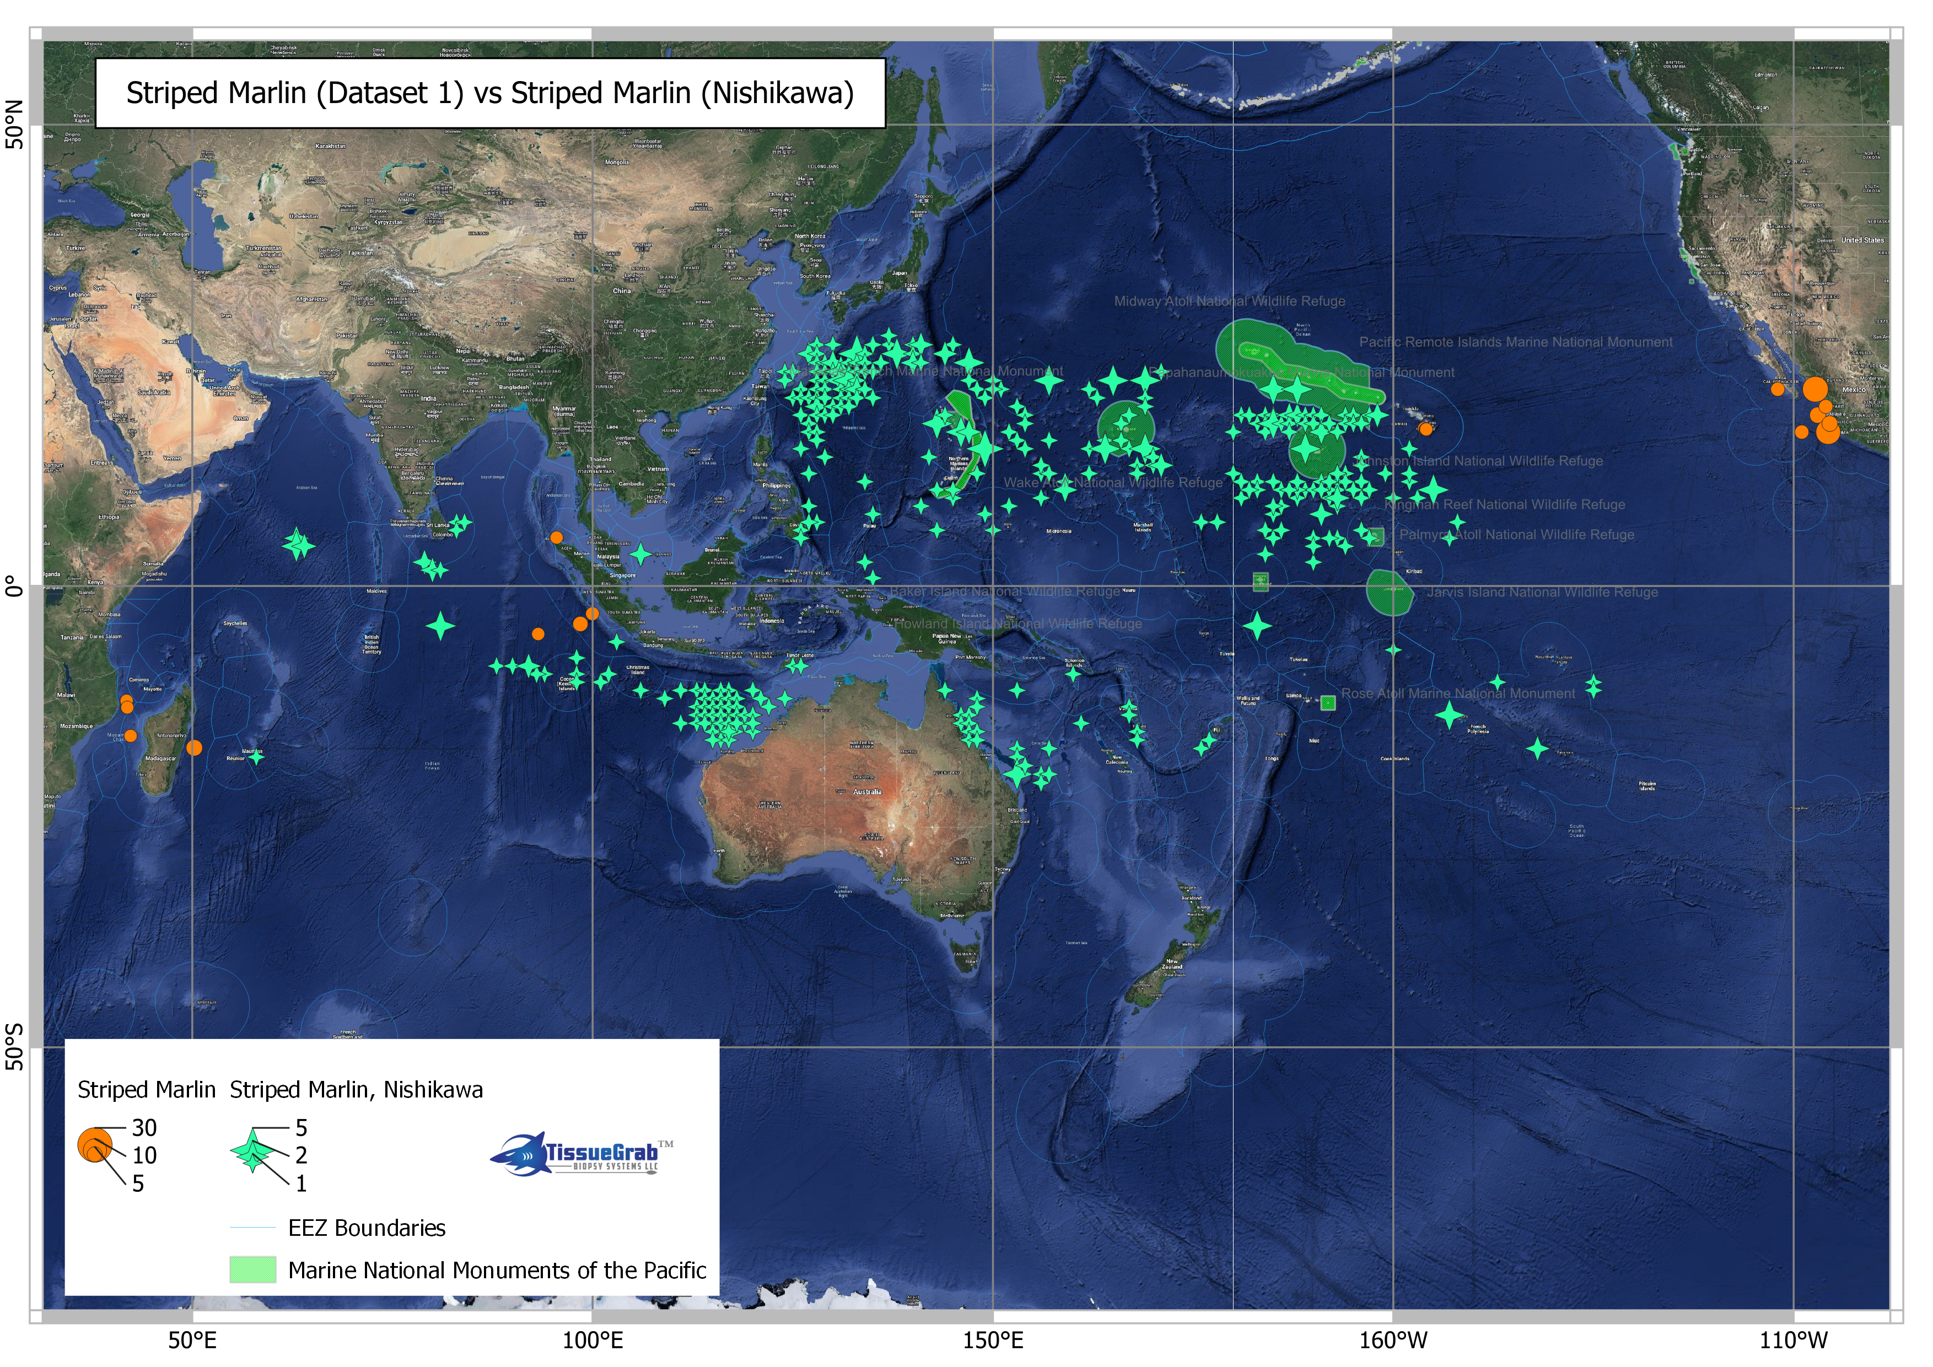

Slide 10
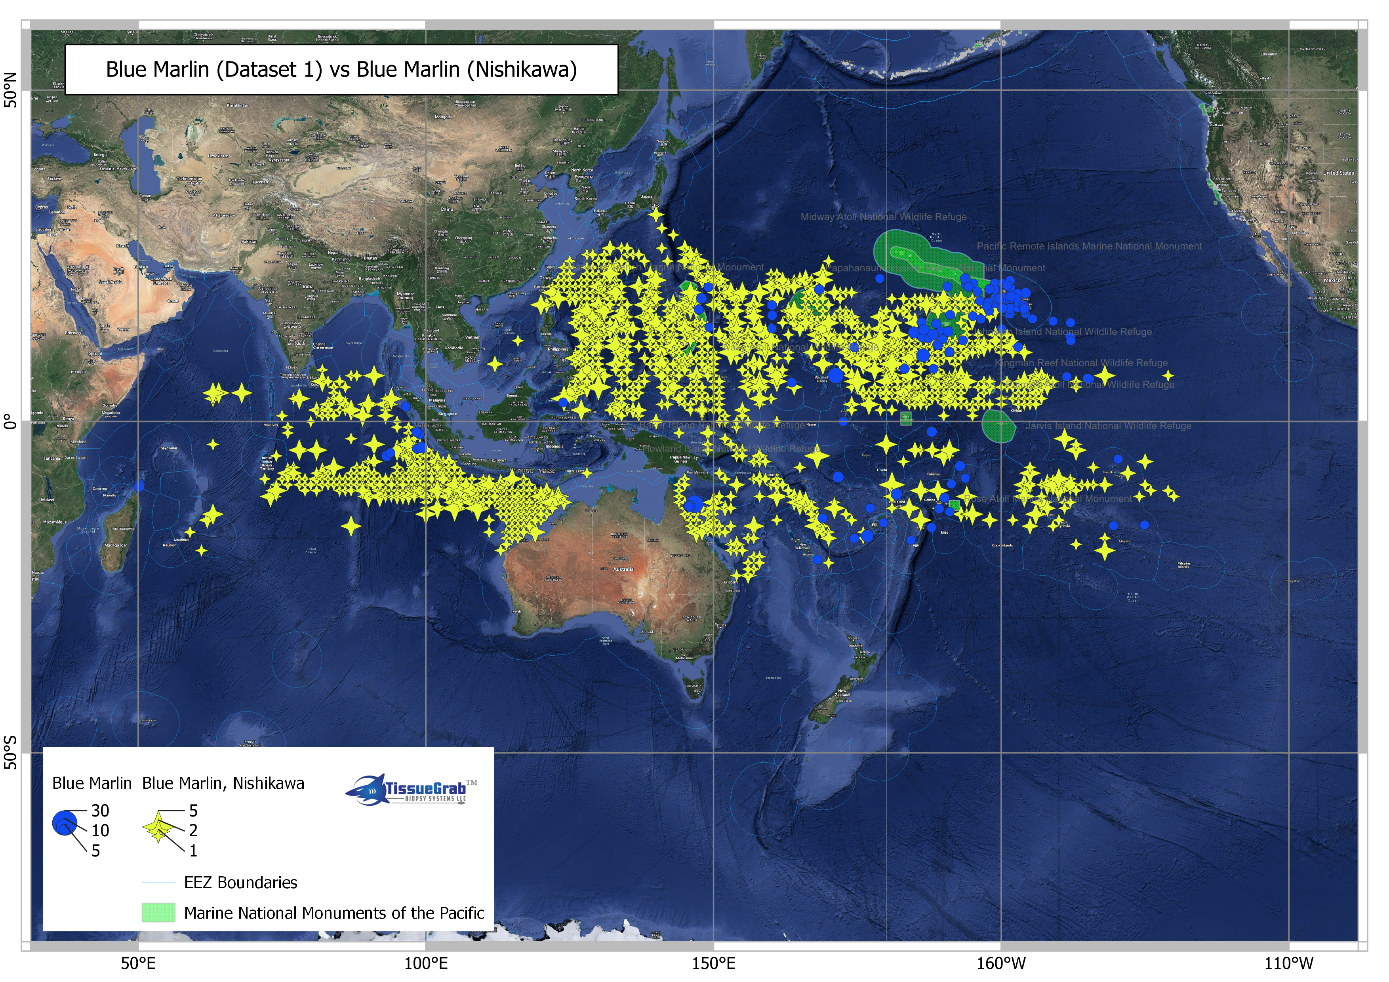

Slide 11
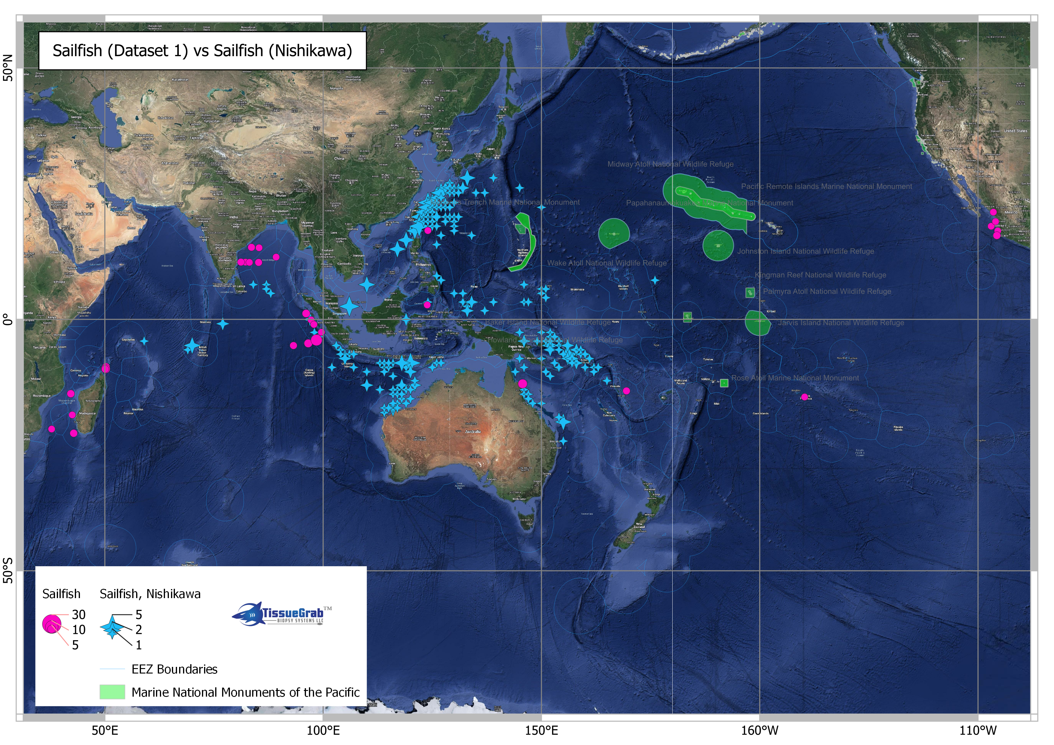

Slide 12
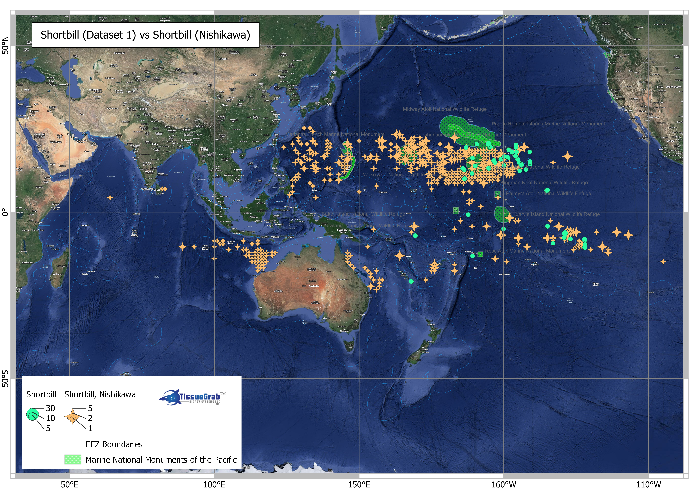

Slide 13
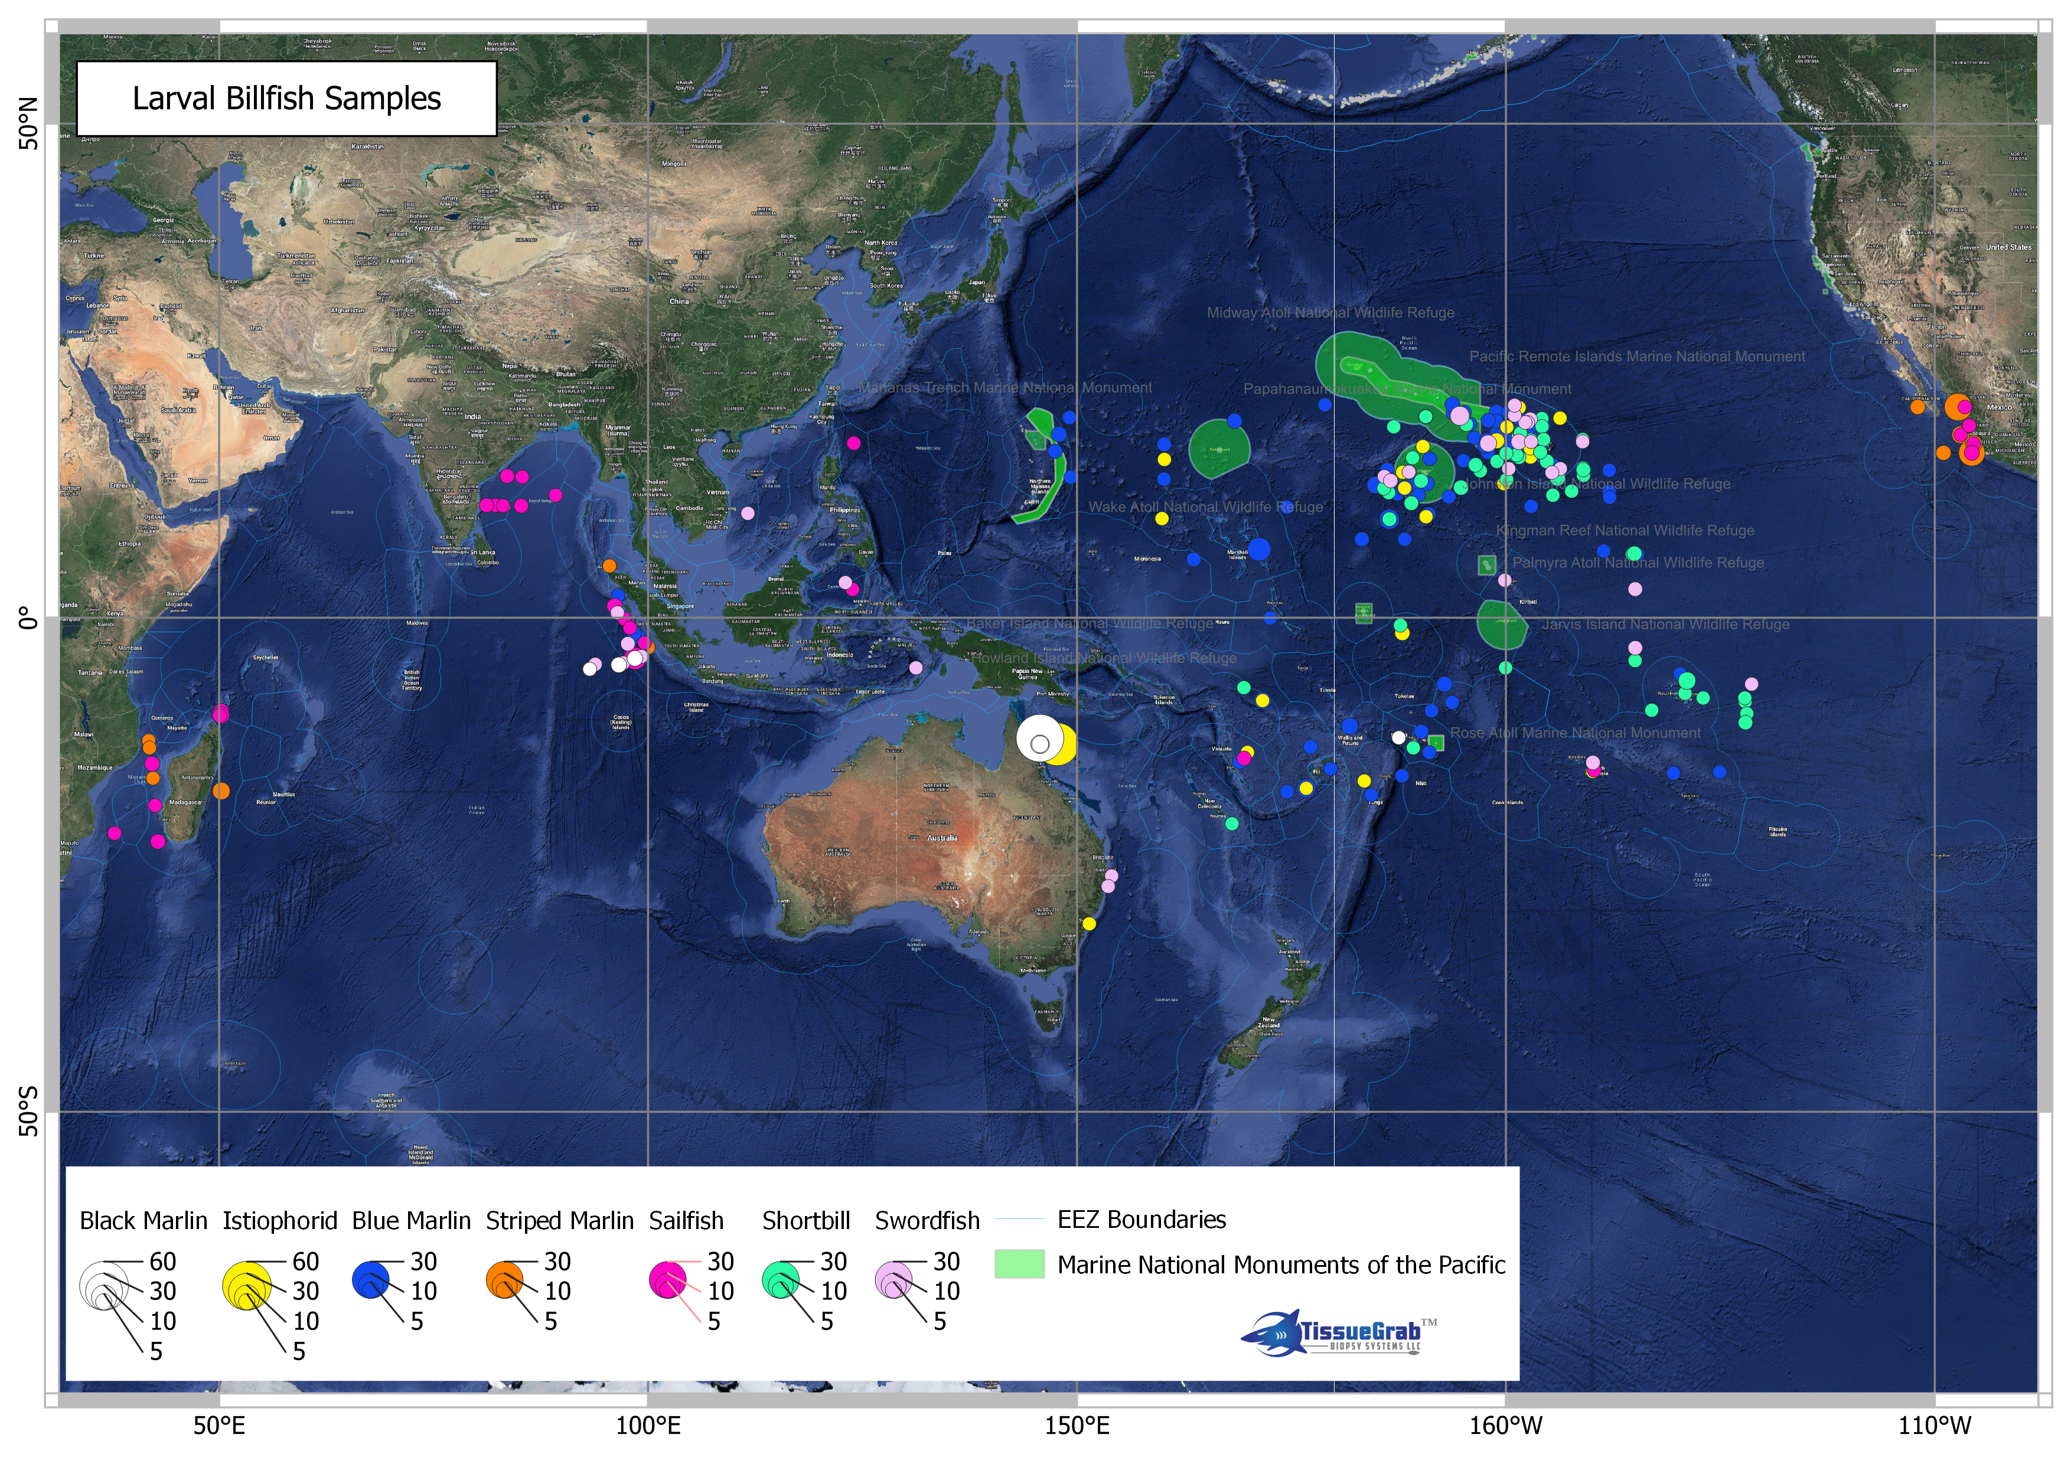
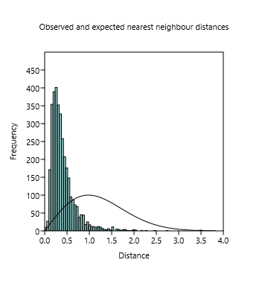
Distribution of larval billfishes in Dataset 1
Point pattern analysis for Complete Spatial Randomness (CSR) using Nearest Neighbours and Ripley’s K functions indicated samples were not randomly distributed but were significantly clustered.

Slide 14
Examining Relationships of larval distribution patterns and seamounts at varying depths

Slide 15
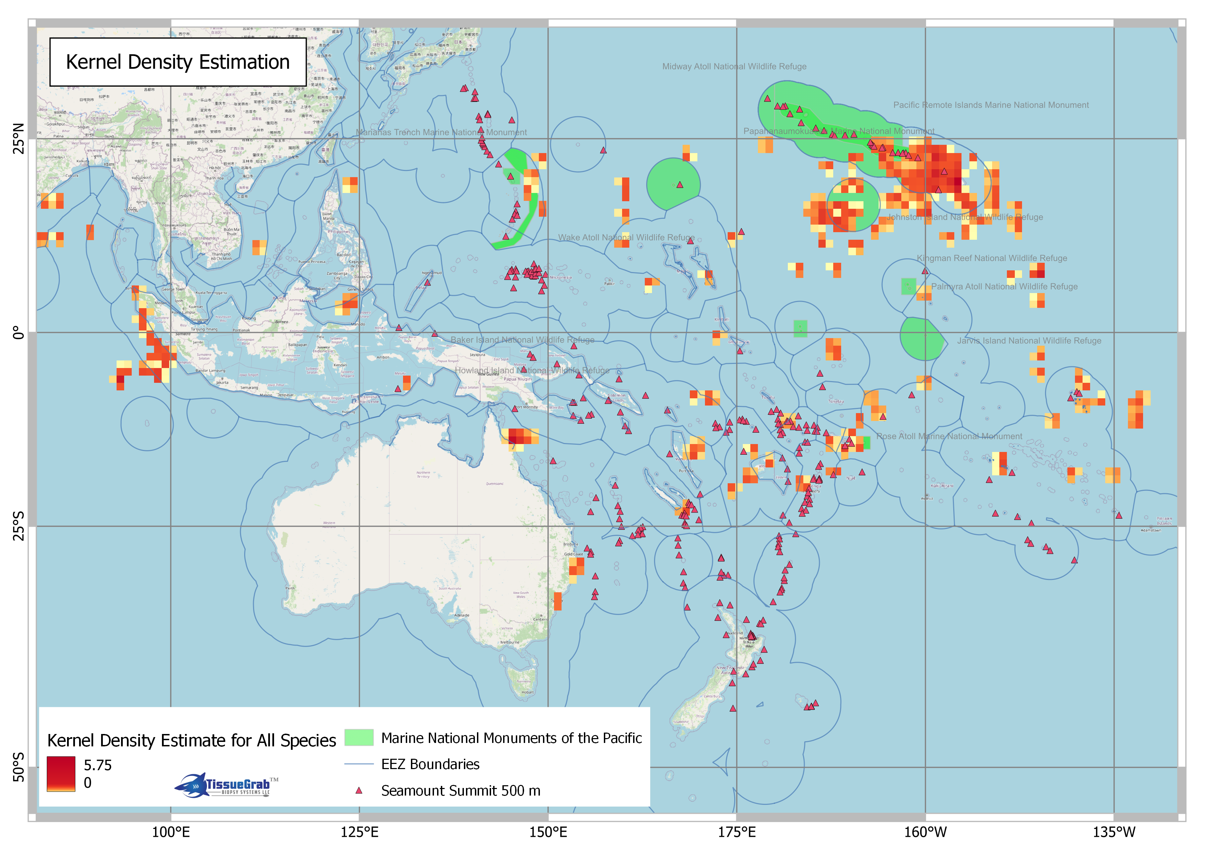

Slide 16
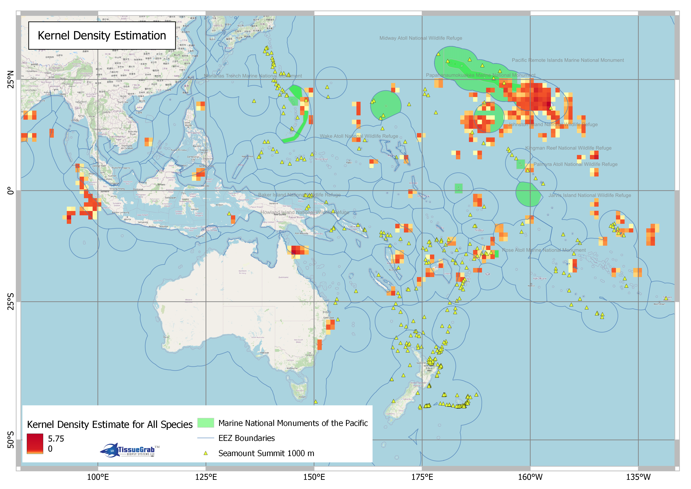

Slide 17
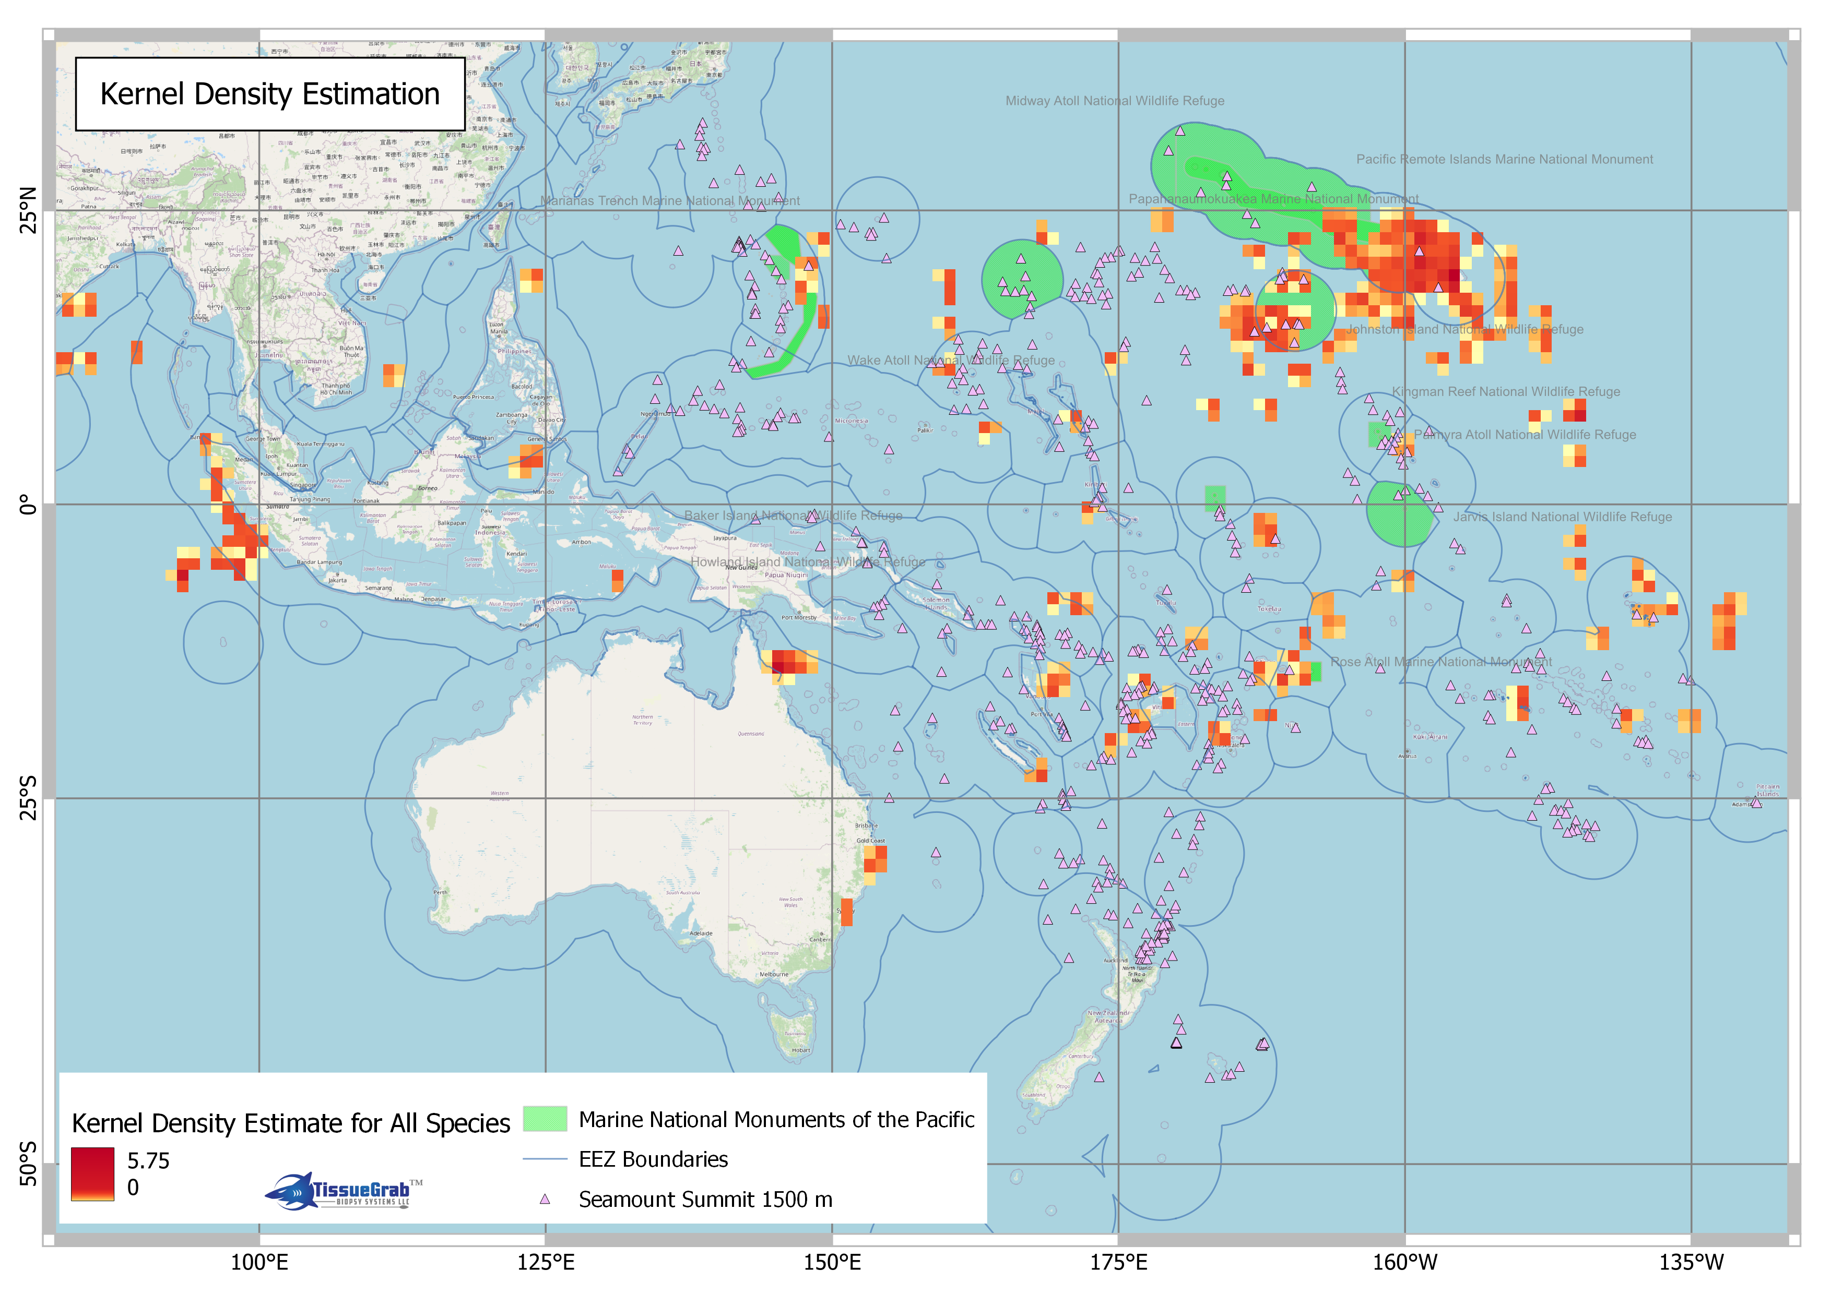

Slide 18
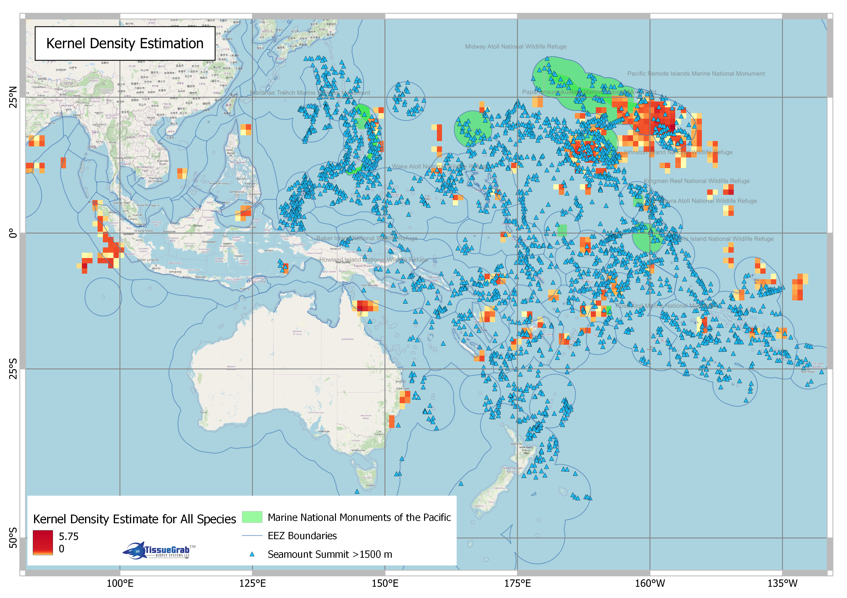

Slide 19
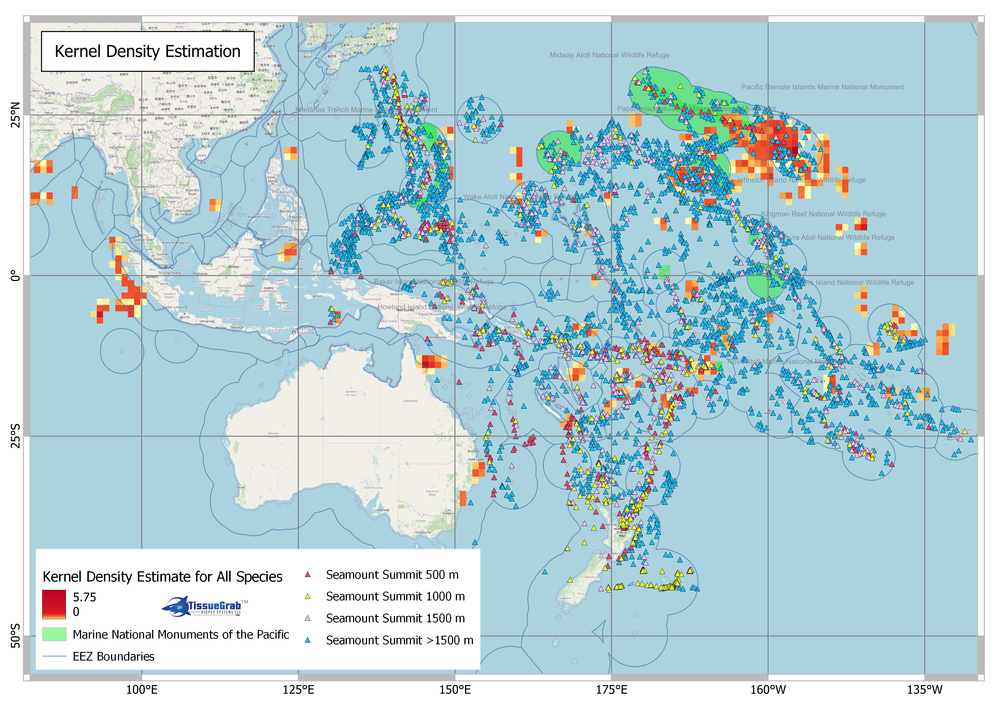

Slide 20
Seamount summit depth class and numbers of larvae detected within 50 nmi footprint
Summit Depth (m) Classes | No. larval detections within 50 nmi of seamount summit footprint
500 | 59
1000 | 26
1500 | 77
>1500 | 729
Grand Total | 891
Regardless of age, 276 individual larvae were detected in the footprints of several seamounts.
In other words, larvae were found in groups mostly at deep seamounts that were also clustered.

Slide 21
Examining seamounts as possible spawning locations?
Shanks (2009) modelled pelagic larval duration and dispersal distances for many species.
From this, our criteria to nominate a putative spawning area:
samples <= 5 days old
straight-line movements confined to within 50 nmi (93 km) from seamount summits.
That is, the maximum distance larvae could travel with an assist from a 0.25 m/sec current travelling in a straight-line for 5 days.
Shanks (2009)

Slide 22
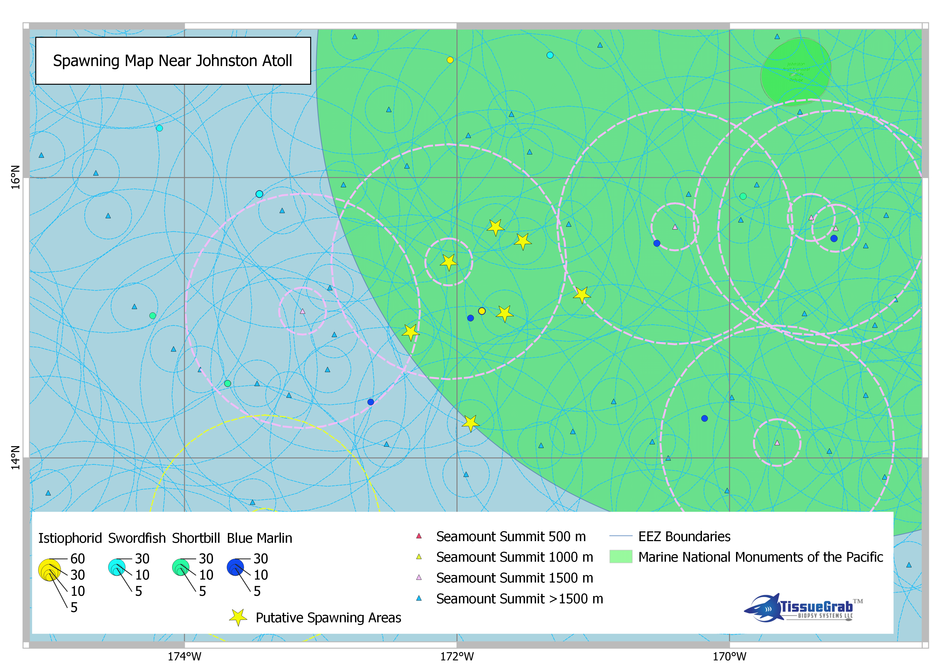
50 nmi
10 nmi

Slide 23
Current vectors around Hawaii have been modelled by Wren & Kobayashi (2016) and Kobayashi (2007). Kobayashi (2007) suggested Johnston Atoll as a possible source and transport corridor of pelagic larvae to Hawaii

Slide 24
Using elemental analysis, Wells et al. (2021) recently suggested several regional spawning areas (BLACK BOXES) for swordfish (RED BOXES are main longline fishing areas).
These regional nurseries indicate a degree of concordance with genetically discrete populations in striped marlin outlined in “Next Steps”

Slide 25
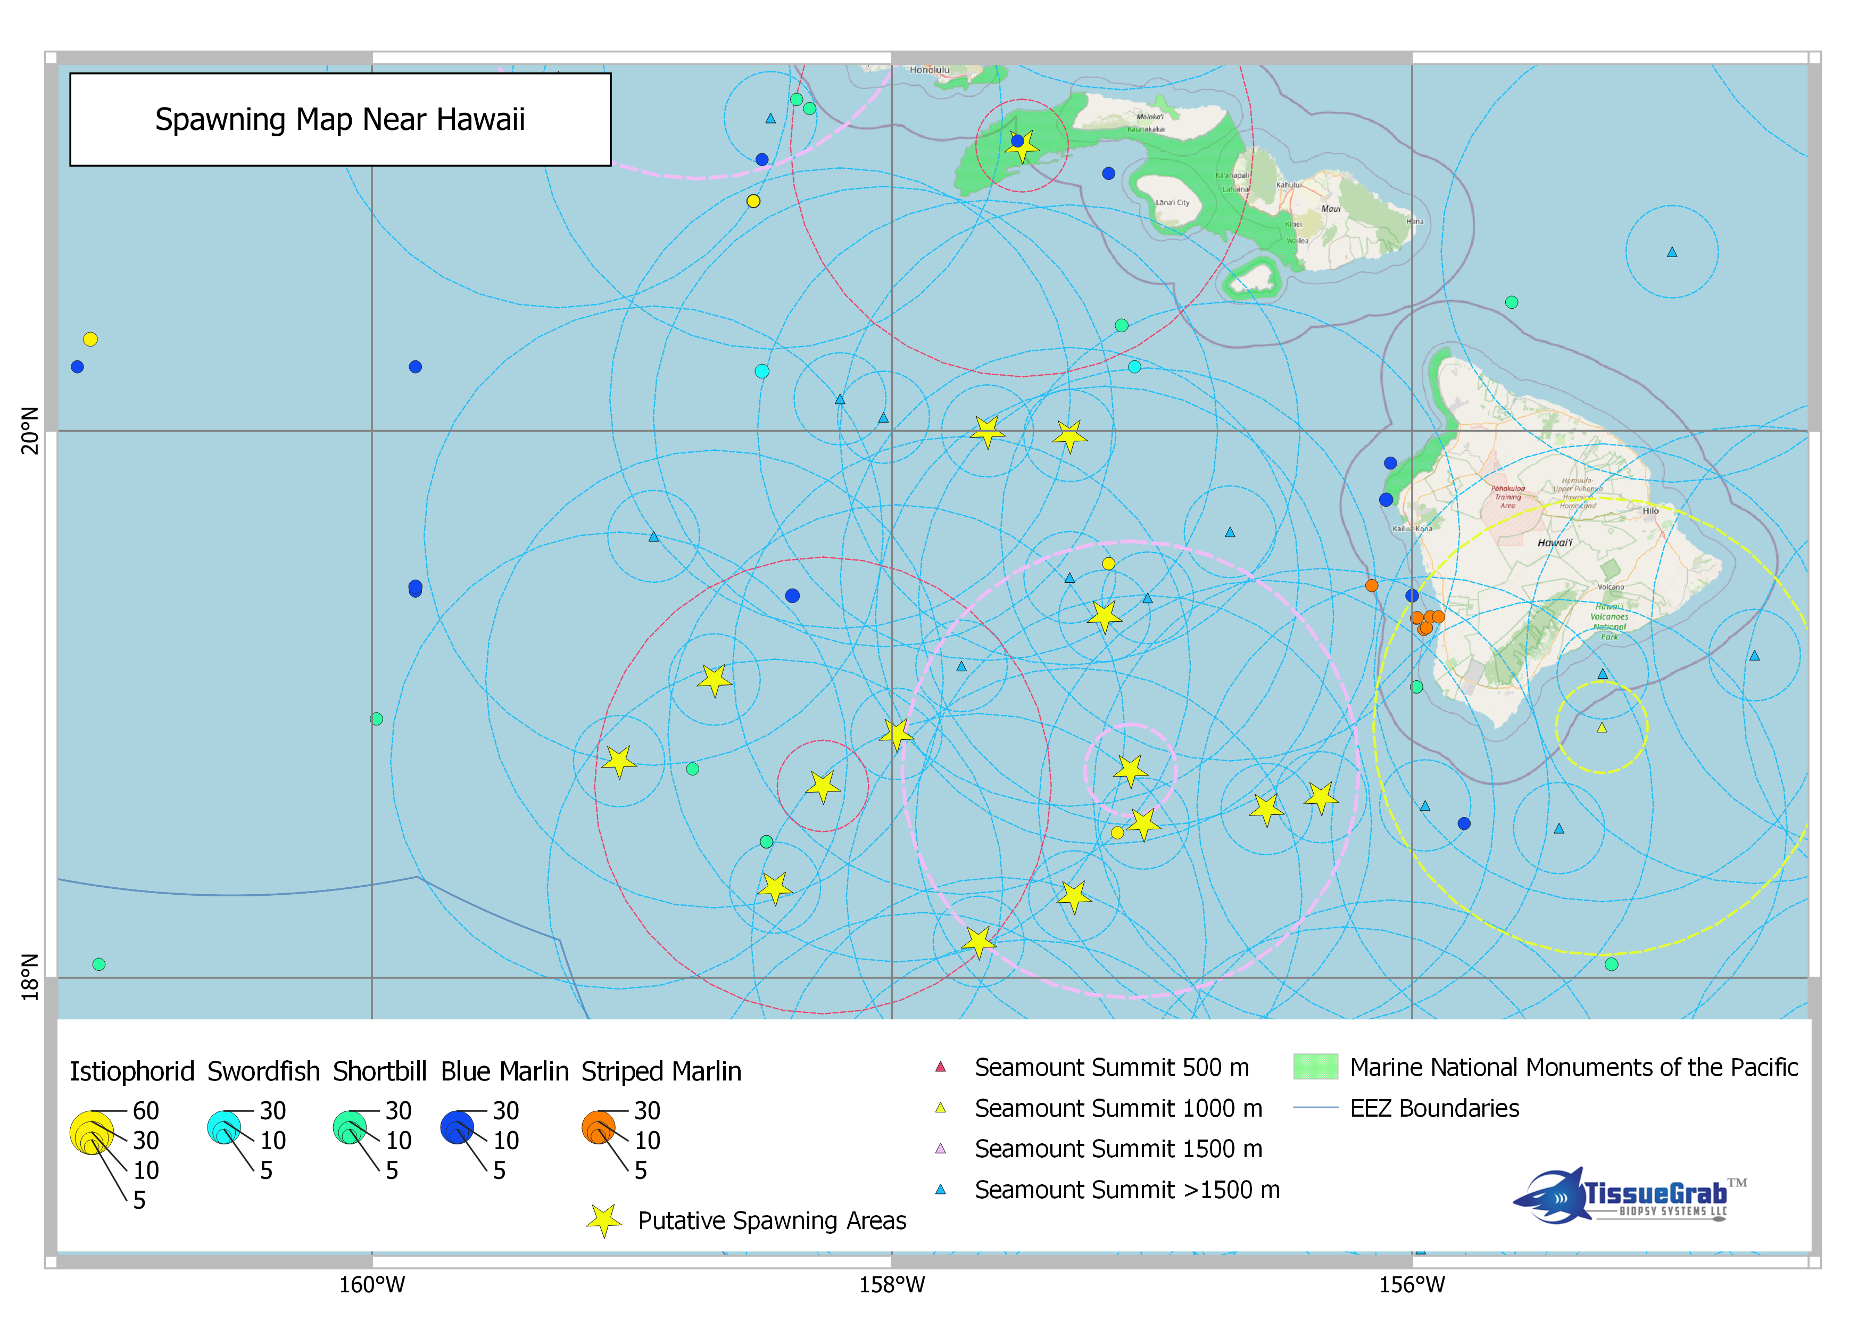
50 nmi
10 nmi

Slide 26
Phase 2 Preliminary Results

Slide 27
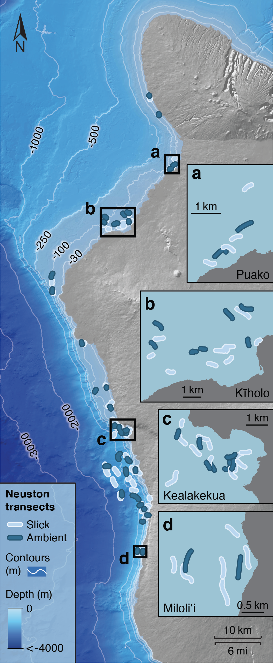
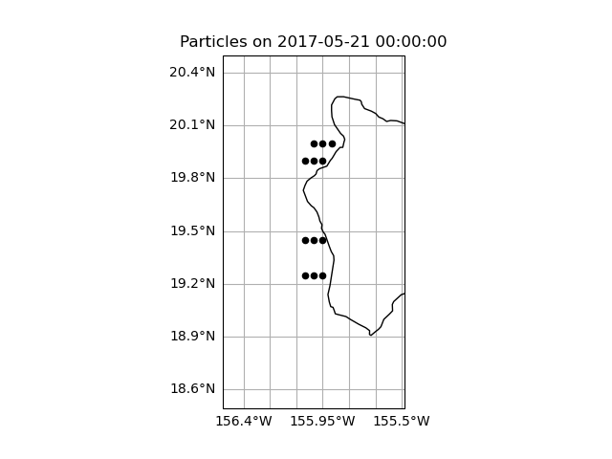
Tracking Larval Fish Movements
with Ocean Circulation Models
In 2017, four larval istiophoridae were captured west of Hawai’i
Catch locations are approximately at the tow sites (a, b, c, and d, far left)
Dates of capture are unknown
They measured 12-14 mm in size
Estimated ages are 19-21 days (from Phase 1)
Sites of tows (2016-2018)
from Gove et al. (2019)
Model placement of catch sites of
Larval Istiophoridae

Slide 28
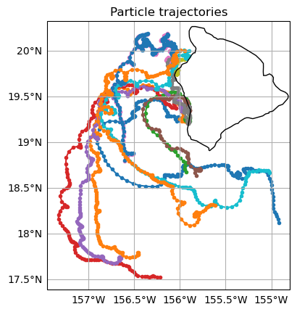
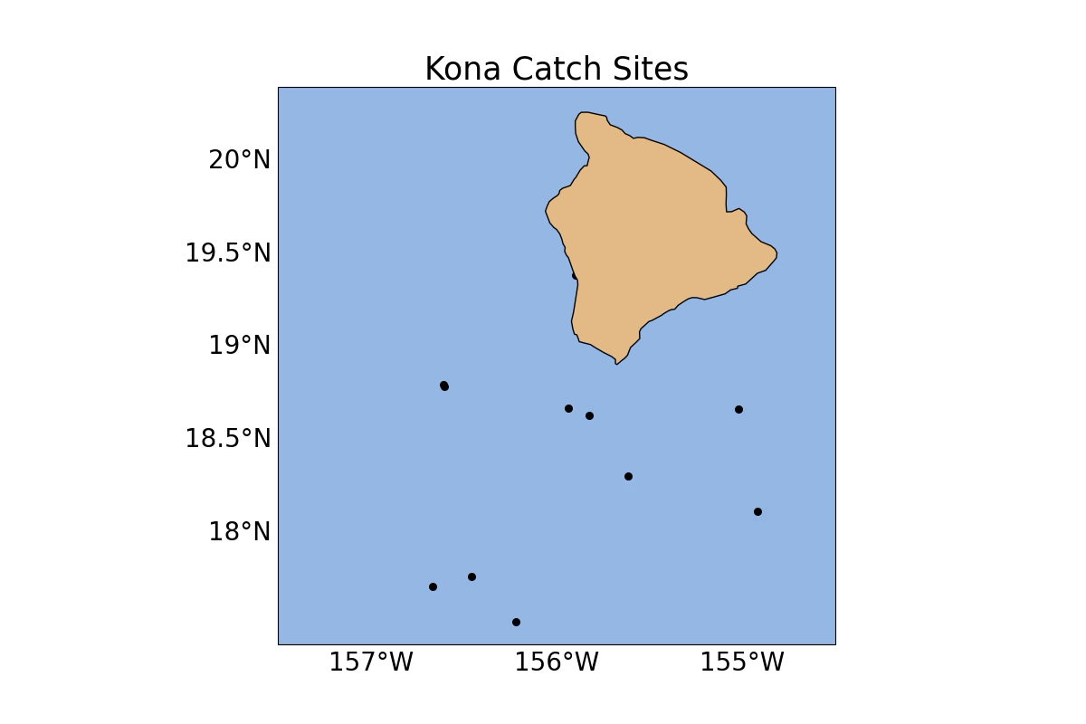
Tracking Larval Fish Movements
with Ocean Circulation Models
Particle positions after 21 days of tracking backward in time, assuming a catch date of 31 May 2017

Slide 29
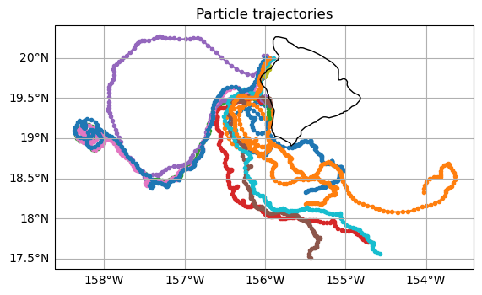
Particle positions at the end of the trajectories may be considered as possible spawning regions
However,
Variability of the flow field is high from active generation and propagation of ocean eddies west of Hawai’i
Ocean models produce estimates of ocean conditions
Ages of Larvae are also estimates
Therefore,
Ensemble simulations are necessary to determine likely spawning regions
Particle positions after 21 days of tracking backward in time, assuming a catch date of 21 May 2017

Slide 30
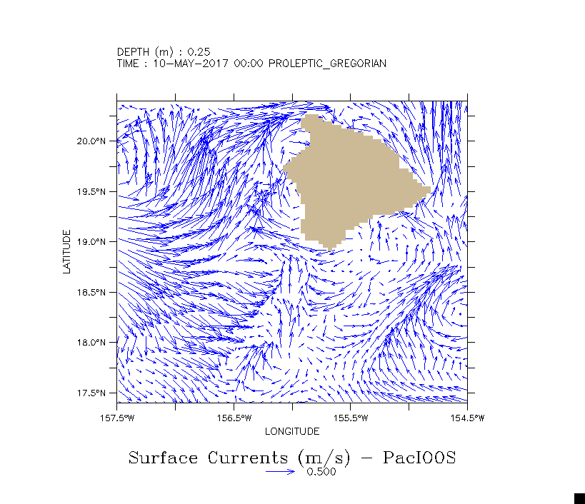
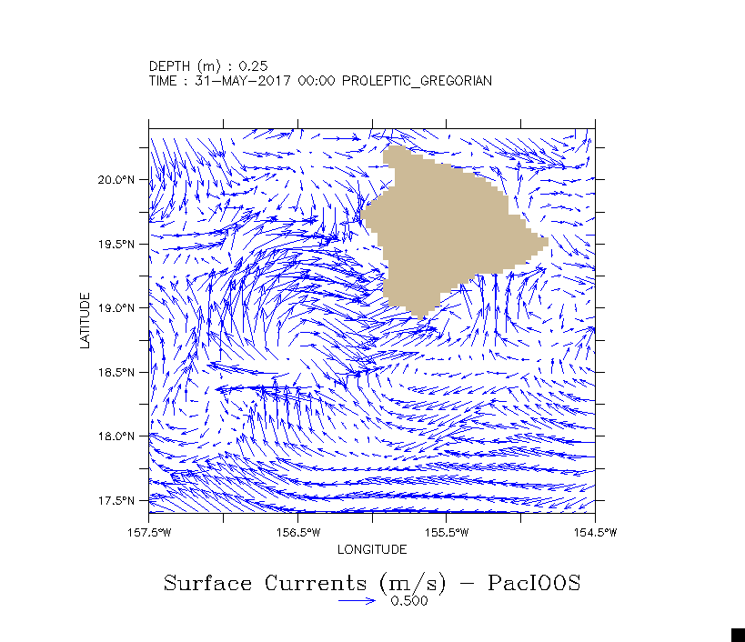
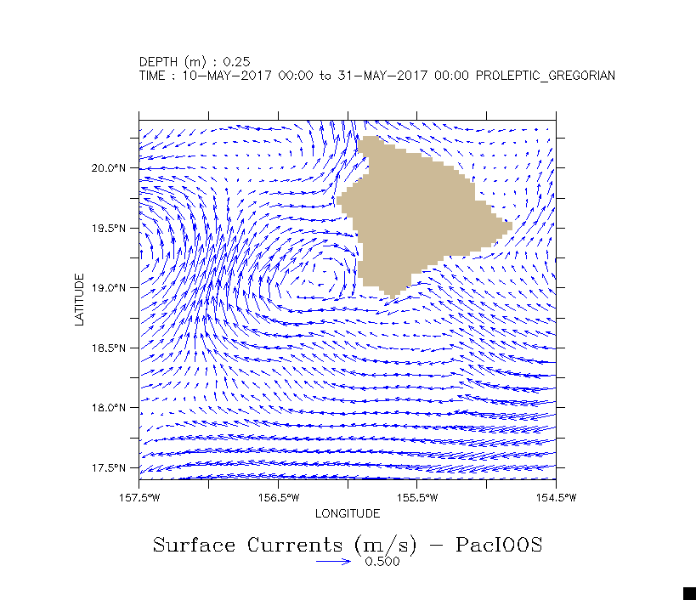
Examples of flow fields and variability in model inputs

Slide 31
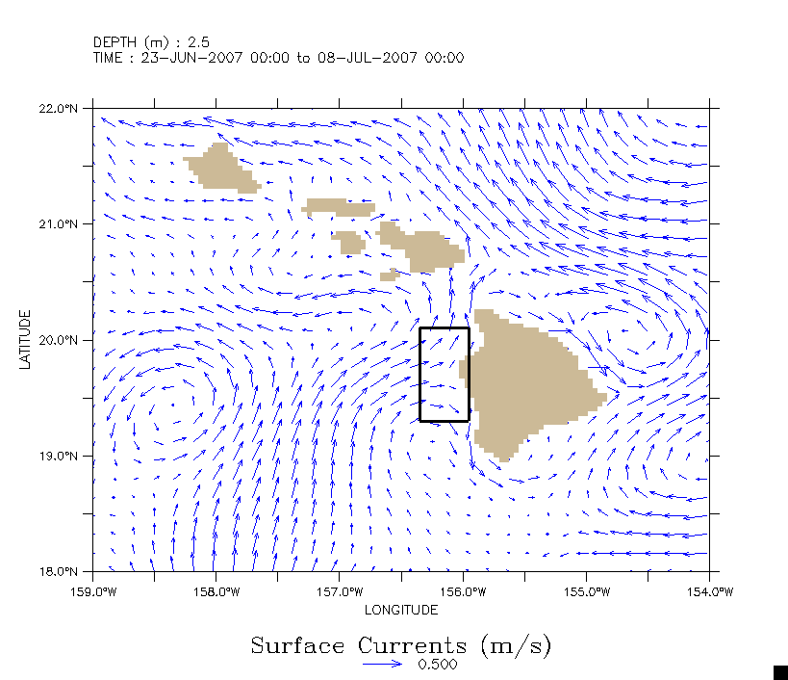
Surface currents for 15 day period

Slide 32
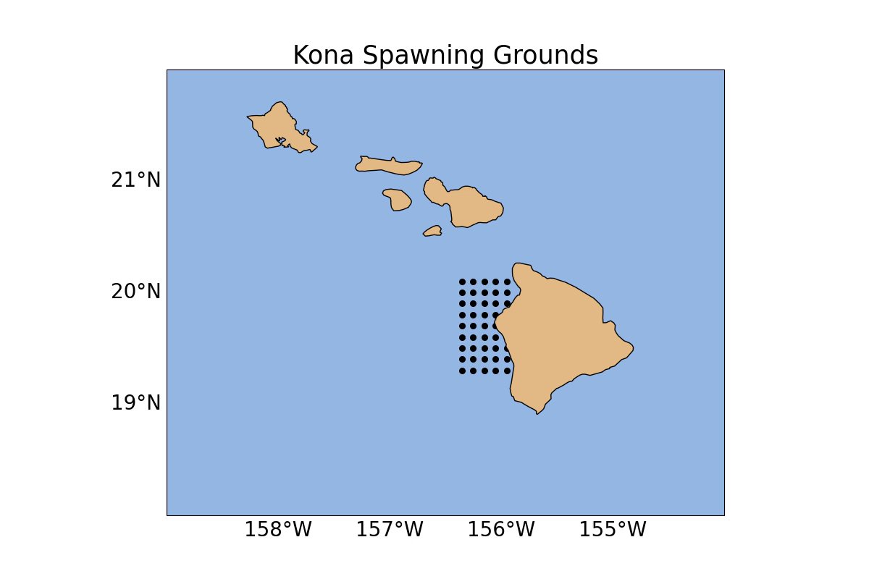
Tracking larval particles forward for 15 day period

Slide 33
Brief Summary of Phase 1 & 2 Findings
Larval billfish species were not randomly or uniformly distributed but the data strongly suggest a clustered pattern (A parallel finding was also evident in the much larger Nishikawa et al. dataset but it was spatially aggregated at ~1.5°[or higher]).
Clustering appeared to be associated with seamounts summits >1500 m or grouped by several deep seamounts.
Project identified several putative spawning areas associated by seamount clusters and in protected areas. The role of deep seamounts with relevance to spawning habitat is not clear but may provide suitable conditions, at least on an ephemeral basis. Taylor columns and currents spinning up nutrients were thought to provide resources for shallow seamounts supporting commercial fisheries and planktonic/larval communities but not for deep seamounts.
Critical habitat factors such as temperature and salinity appeared to be narrow for larval samples. Temperature has a profound effect on physiology, metabolism, stress, fitness, growth and survival and salinity is import for maintaining osmotic and ionic balance and buoyancy. These variables, along with chlorophyll-a, might be suitable parameters when assessing and/or predicting the quality and quantity of available spawning habitat which can be correlated later with recruitment in the adult population.
The project developed the first age & growth model for Pacific billfish larvae.
Phase 1

Slide 34
Brief Summary of Phase 1 & 2 Findings
As outlined, findings in the project have ramifications for identifying potential billfish spawning habitat and managing adult populations. By knowing where larvae spawn and are distributed, this will inform what prognostic factors shape the habitat so it can be preserved. What about near-shore runoff and pollution impacting habitat? Do these putative offshore spawning habitats provide the bulk of recruits?
Findings in Phase 1 will be incorporated into Phase 2 which will examine potential spawning areas near Hawaii and prognostic factors shaping the spatial-temporal variability in habitat using ocean circulation models. The model can be used to locate possible spawning origins and also to estimate where larvae are propagated through time.
As an example, do older larvae move to other habitats as they grow? Using information from the age & growth model in Phase 1, can it be determined when larvae switch from passive to active movements? How does variation in current vectors shape the temporal-spatial variability in important oceanographic parameters that influence habitat quality and suitability?
Phase 1
-----------
Phase 2

Slide 35
Next Steps
Given the findings to date, the logical next steps in this research are myriad but can be adequately summarized using striped marlin in the Pacific as an example.
Firstly, from the literature, it is clear that there are misidentifications of larval billfish samples to species level using morphological characters. The rate of this misidentification is unknown but it is probable striped marlin and blue marlin larvae are mixed-up (the same occurrence happens in adults). Therefore, initiatives should be undertaken to genetically ID preserved samples held in various institutions. This will allow morphological series to be constructed through ontogeny to improve field keys.
Next, from the presence of larvae, it is clear striped marlin spawn in at least 2 different regions in the Pacific: near Baja and Kona, Hawaii. How much does each region contribute to the fished stock?
Conventional and satellite tagging indicate movements of adult striped marlin from Baja to New Zealand and from Baja into the Hawaii-based commercial longline fishery. Striped marlin tagged in Hawaii have also been shown to transit to Australia.
Next Steps

Slide 36
Next Steps
Reproductive studies in Hawaii indicated that some individuals collected by the Hawaii-based longline fishery were “out of phase” with cohorts. Tagging indicates fish tagged near Baja enter this fishery. Age and growth studies indicated differences in parameters from eastern and central Pacific samples. Is this evidence of a mixed stock fishery?
Genetic studies on striped marlin in the Pacific suggested a complex mixture of populations in Kona, Hawaii that may comprise perhaps two distinct populations. In blue marlin sampled in Kona, a deficiency of heterozygotes at several enzymatic loci led Shaklee et al. to hypothesize the existence of a Wahlund effect or the possible admixture of separate populations. Additional genetic studies and/or otolith fingerprinting may be necessary to figure out boundaries/contributions of the mixed stock. Recent volcanic activity near Hawaii may provide a strong signal in fingerprints. An ISC(2022) stock assessment of striped marlin indicated a decline in age-0 recruits. If spawning habitat is degraded, less fish will enter the fishery. The words “Habitat”, “larvae” or “larval” were not found in the assessment.
Studies in Kona indicated that of seven striped marlin larvae collected, all had different mothers. If maintaining genetic diversity requires large numbers of female breeders, how important are older mothers to the contribution of fitness, effective population sizes and reproductive success? Parental biomass may need protection and catch and release in longline and recreational fisheries has been demonstrated an effective management strategy. Recent studies suggest effective population sizes might be large in striped marlin.
Next Steps

Slide 37
Next Steps
Either by expanding Phase 2 or in collaboration, investigate what endogenous or exogenous factors are responsible for variation in larval abundance patterns where they are found regularly. From this exercise, it may be possible to outline and describe the quality of and quantity of suitable habitat over temporal-spatial scales.
In select areas, larval and egg traps could be deployed as a recent study in Florida suggested to gain information on patterns in abundance.
A repository of larval records on billfish could be designed and maintained where new records could be added (much like IMOS initiative in Australia). It can be as simple as a spreadsheet.
It is possible examination of gill parasites could shed insights on identifying mixed stocks.
Given that sex determination in pelagic eggs is influenced by temperature, how will climate change effect sex ratios and what does this portend for the population?
Next Steps

Slide 38
Deliverables
Phase 1 will complete the final report in April and will submit a draft for publication in the peer-reviewed literature. Publication will take ~2-3 months after submission. The final database will be submitted at the time of publication.
Phase 2 has plans to complete the initial study simulations and report in ~July/August
Deliverables

